Slide 1
Multiscale and integrative single-cell Hi-C analysis with Higashi
Reproduction of the experiment
Group member:
何彥南、張修誠、陳偉瑄
Ruochi Zhang, Tianming Zhou, and Jian Ma. Nature biotechnology 40.2 (2022): 254-261.
Notes:
Hello everyone
we are bioinfo lab member
today we would like to continue this study and some more about implementation

Slide 2
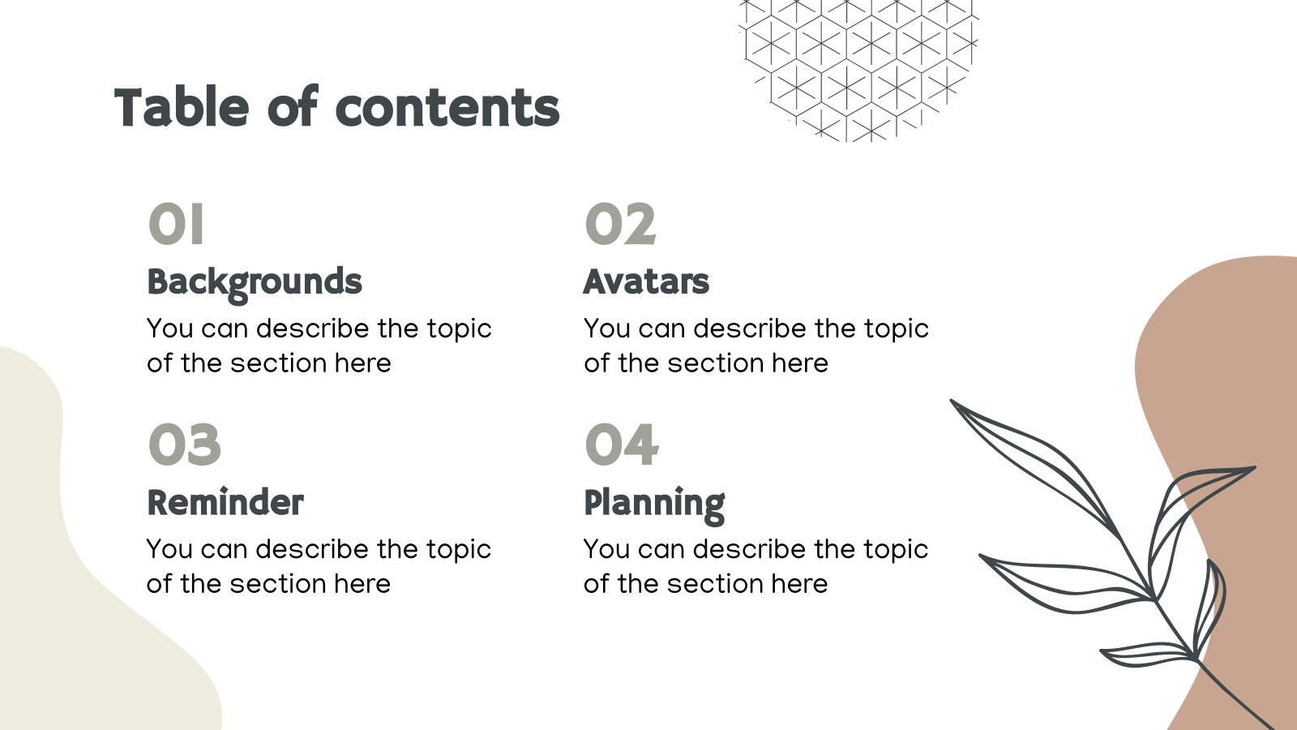
01
01
02
02
03
04
Introduction
Methods
Results
Our Reproduction
Notes:
we then recap for paper content also
so there are introduction, methods, results for paper
and some show on our reproduction

Slide 3
01
Introduction

Slide 4
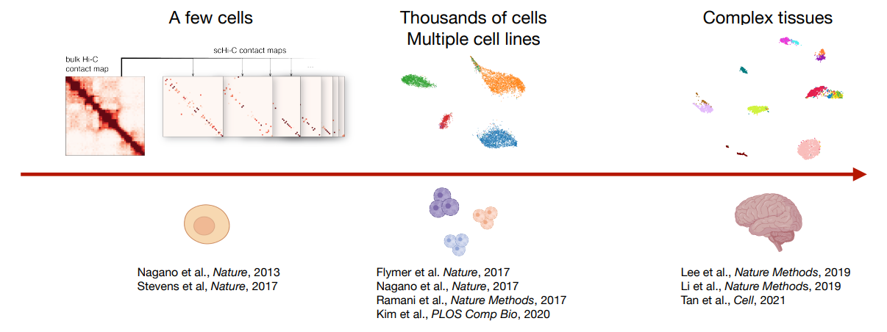
Single cell Hi-C reveals heterogeneity of genome organization
Challenges
High dimensionality
Sparse and noisy data
Co-assayed scHi-C
Goals
Generate embeddings
Impute sparse contact maps
Extract multi-scale 3D genome features
DNA methylation
Notes:
due to the way hi-c appears
we could observe genome representation base on 3-d gene feature through bulk data
however there is complicated nature and many variants in expirement that lead to difference in Chromosome conformation
Recently some new tech like scHi-C such as Single Cell anaysis approach developed and expansion more fast in scale of cell observation
But there are more challenge for it.

Slide 5
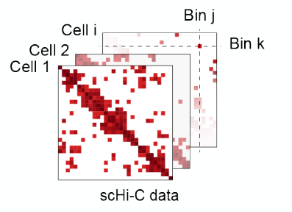



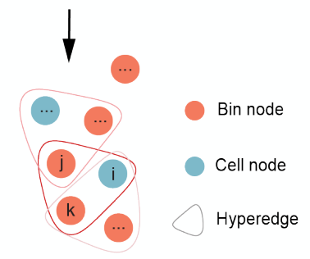
Modeling scHi-C data as a hypergraph
A hypergraph
: the set of nodes / hyperedges
: a hyperedge connects two or more nodes
Non-zero entry in contact matrix →
Co-assayed signals → node attributes
Each Non-zero entry is composed of one cell node and two bin nodes, representing the interaction of some part of chromatin.
Hypergraph representation learning
Embeddings for the nodes → Embeddings for cells
Predict the missing hyperedges → Imputation of contact maps
Predict node attributes → Joint modeling of co-assayed signals
Notes:
to fulfil purpose, author use concept of hypergrah such as some extension in graph
there are node and edge which be able to include more than two nodes called as hyperedge
we expected that convert single cell Hi-C contact map into form Hypergrah
there are two type : cell and bin node, cell node represent each cell, and bin node means each bin comes from contact map
on the contact map of single cel Hi-C, non-zero observation as colored represent as hyperedge like between one cell node and two bin node, and regard co-assayed signals as node attribute
moreover, there are few intention..

Slide 6
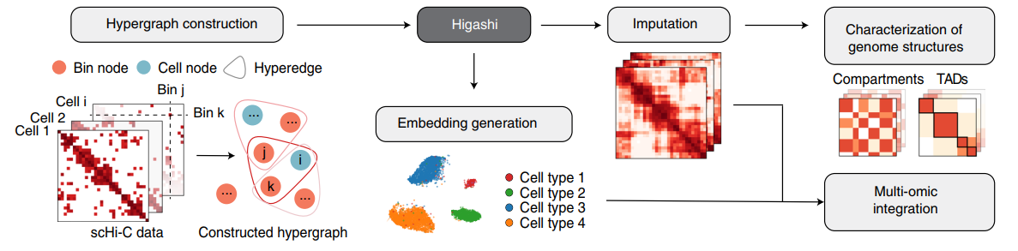
Overview of the Higashi framework
Advantages
Integrate embedding and data imputation for scHi-C in the same formalism
Flexibility to analyze co-assayed scHi-C datasets
Incorporate the latent correlations between cells to enhance overall imputation
Notes:
Higashi has five main components.
(1) Each cell and each genomic bin are represented as cell node and genomic bin node as a hypergraph.
Each non-zero element in the single-cell contact map is modeled as a hyper-edge connecting the corresponding cell and the two genomic loci of that particular chromatin interaction (Fig. 1a).
(2) Training a hypergraph neural network (NN) based on the constructed hypergraph (Supplementary Figs. 1 and 2).
(3) Cell nodes embedding vectors extraction from the trained hypergraph NN for downstream analysis.
(4) To get more detailed and reliable characterization of 3D genome features, use the trained hypergraph NN to impute single-cell Hi-C contact maps with the flexibility to incorporate the latent correlations among cells to enhance overall imputation.
(5) With several new computational strategies, we reliably compare A/B compartment scores and TAD-like domain boundaries across individual cells to promote the analysis of cell-to-cell variability of these large-scale 3D genome features and its implication in gene transcription.
Moreover, author developed a visualization tool to allow interactive navigation of the embedding vectors and the imputed contact maps from Higashi to facilitate discovery.
----
Overview of Higashi:
Overall, the process of embedding the scHi-C data is now equivalent(əˈkwiv(ə)lənt) to learning node embeddings of the hypergraph, and imputing the scHi-C contact maps becomes predicting missing hyperedges within the hyper-graph.
Figue step:
We represent the scHi-C dataset as a hypergraph and train a hypergraph neural network (NN) based on the constructed hypergraph .
each of non-zero entry in this scHiC contact map，can construct one hypergraph incuding one cell node & two Bin node
We extract the embedding vectors of cell nodes from the trained hypergraph NN for downstream analysis.
Then We can use the trained hypergraph NN to impute single-cell Hi-C contact maps with the flexibility to incorporate the latent correlations among cells to enhance overall imputation, enabling more detailed and reliable(rəˈlīəb(ə)l) characterization of 3D genome features.
將資料與問題轉換成超圖的形式解決，原先 scHi-C 資料的 embedding 會變成學習超圖中節點間關係的 embedding ，而 scHi-C 的 imputing 方式從原本 contact map 的方式變成預測超圖中可能遺失的超邊。
首先我們將 scHi-C 的 contact map 轉換成超圖的形式，並訓練超圖神經網路。
利用訓練完的超圖，我們就可以基於細胞間的潛在關系，在回頭去補 scHi-C contact map 的資訊。
—---------------------------------------------------------------------------------------------------------------------------------------------------------------------------------------------------------------------------------------------------------------------------------------
Overview of Higashi
Specifically, the process of embedding the scHi-C data is now equivalent to learning node embeddings of the hypergraph, and imputing the scHi-C contact maps becomes predicting missing hyperedges within the hyper-graph.
將資料與問題轉換成超圖的形式解決，原先 scHi-C 資料的 embedding 會變成學習超圖中節點間關係的 embedding ，而 scHi-C 的 imputing 方式從原本 contact map 的方式變成預測超圖中可能遺失的超邊。
Higashi has five main components.
(1) We represent the scHi-C dataset as a hypergraph, where each cell and each genomic bin are represented as cell node and genomic bin node, respectively. Each non-zero entry in the single-cell contact map is modeled as a hyper-edge connecting the corresponding cell and the two genomic loci of that particular chromatin interaction (Fig. 1a).
首先我們將 scHi-C 的 contact map 轉換成超圖的形式。細胞和基因bin 都轉換成節點，contact map 中所有 non-zero entry (指的就是 heatmap 中非 0的格子)都當作超邊。超邊可以作為細胞與細胞間的連結或是基因組未點之間的連結。
(2) We train a hypergraph neural network (NN) based on the constructed hypergraph (Supplementary Figs. 1 and 2).
訓練超圖神經網路
(3) We extract the embedding vectors of cell nodes from the trained hypergraph NN for downstream analysis.
透過從訓練完的超圖中抽取細胞節點的 embedding vectors 去做後續分析
(4) We use the trained hypergraph NN to impute single-cell Hi-C contact maps with the flexibility to incorporate the latent correlations among cells to enhance overall imputation, enabling more detailed and reliable characterization of 3D genome features.
利用訓練完的超圖，我們就可以基於細胞間的潛在關系，在回頭去補 scHi-C contact map 的資訊。
(5) With several new computational strategies, we reliably compare A/B compartment scores and TAD-like domain boundaries across individual cells to facilitate the analysis of cell-to-cell variability of these large-scale 3D genome features and its implication in gene transcription. In addition, we developed a visualization tool to allow interactive navigation of the embedding vectors and the imputed contact maps from Higashi to facilitate discovery.
為了從大量的 3D 基因特徵中去分析細胞間的變異性以及它與轉錄之間的意義，我們比較了 A/B compartment scores 和 TAD-like domain boundaries across individual cell

Slide 7
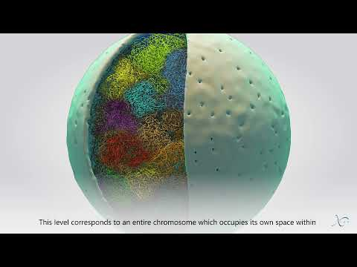
3D genome organization
Notes:
Recently, Hi-C gives insight to high order visual
there is a short film introduce to some method about it ,
and a opening as followed result chapter

Slide 8
02
Methods

Slide 9
scHi-C data and other genomic data processing
Single-cell Hi-C datasets
Ramani et al.14: (GEO) GSE84920 👉🏼 we use
Nagano et al.15: (GEO) GSE94489
4DN sci-Hi-C20: (4DN Data Portal) 4DNES4D5MWEZ, 4DNESUE2NSGS, 4DNESIKGI39T, 4DNES1BK1RMQ and 4DNESTVIP977
WTC-11 iPSC line: (4DN Data Portal) 4DNESF829JOW and 4DNESJQ4RXY5
Data processing
For all scHi-C datasets, we kept only the cells with more than 2,000 read pairs that have genomic span greater than 500 Kb. At a given resolution, we define the number of contacts per cell as the number of interaction pairs (read count) assigned to the non-diagonal entries of the intra-chromosomal contact maps.
Notes:
there are some dataset for your information
on preprocessing,data keeping on scale condition and given resolution to measure the contact map
for all dataset, we make sure it’s fair in principle. so even Higashi could include interaction by corresponding hyperedges. It’s unreliable that not sufficient amount of inter-chromosomal contacts.

Slide 10
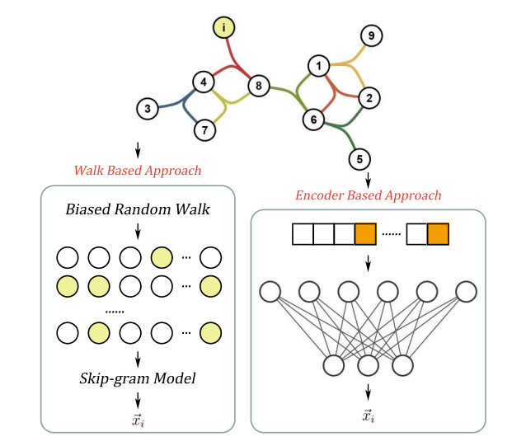
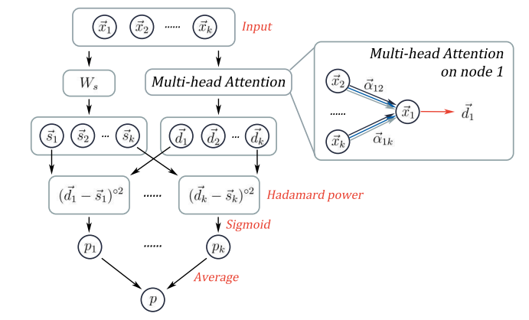
Hypergraph NN architecture in Higashi
Hyper-SAGNN
The model aims to predict the value of an entry (that is, contact frequency) in an scHi-C contact map using the rest of the contact map as input. The model also has the option to use the contact maps from cells that share similar 3D genome structures (that is, close to each other in the embedding space) as auxiliary information for the prediction as well.
Notes:
hence, for each cell, all need is learn to represent self on vector space.
input as k cells and output with corresponding class for this model
before training there some feature base for sure. one base on random walk to skip-gram model , another is encoder based multi layer approach
after feature engineering, model construction from static / dynamic and classification the three part.
Author extract transformer approach to form that corresponding static and dynamic to position and self-attention of transformer.

Slide 11
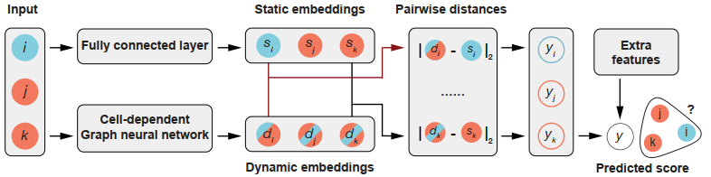
Hypergraph NN architecture in Higashi
The structure of the hypergraph neural network
The input triplet consisting of one cell node and two bin nodes passes through two branches of the network to generate static embeddings and dynamic embeddings for each node, respectively. Then the pairwise distances between static and dynamic embedding pairs are calculated. These pairwise distances are combined with extra features such as genomic distance between the two bins to produce the final predicted score for the input triplet, which represents the probability of an entry in the single-cell contact map.
Notes:
as you can see
higashi model construct from one cell node and two bin node.into static and dynamic embedding
throughout calculating distance of static and dynamic pair to pair
these pairwise distance forming with extra entries, eventually generate prediction which represent probability of element(entry) on single cell contact map

Slide 12

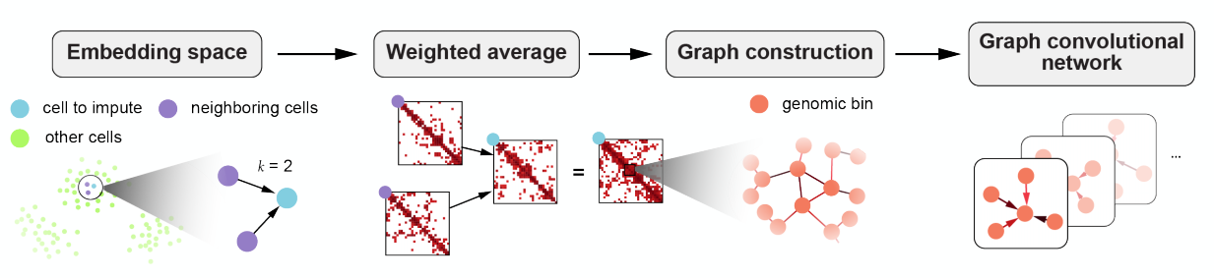
Controlling information transferred across cells
Hyper-parameter 𝒌
For , its 𝒌-nearest neighbors in the embedding space would contribute
Graph convolutional network learns the embeddings for bin nodes
𝒌 = 4 for all results in this presentation
Notes:
some key design mention for Higashi,
eariler we talked about some advantage that imputation to different cell
to avoid discrete information, there is contribution for k-nearest neighbor
, then using weighted average, genomic bin graph and GCN to learn.

Slide 13
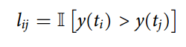
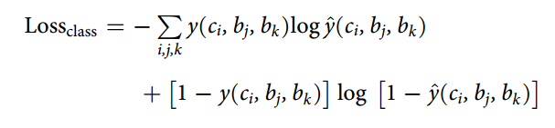
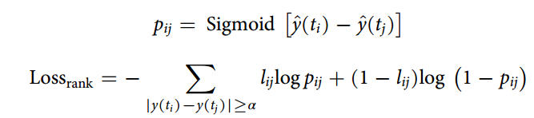
Loss function and training details of Higashi
The hypergraph NN in Higashi produces a score yˆ for any triplet (ci, bj, bk). The NN is trained to minimize the difference between the predicted score yˆ and the target score y (that is, the observations in the dataset), indicating the probability of the pairwise interaction between bin nodes bj and bk in cell ci. In Higashi, we offer several choices of loss function for scHi-C datasets with different coverage:
Binary classification loss
For scHi-C datasets with relatively low sequencing depths, or the analysis resolution is high (hence, fewer reads in each genomic bin), the model is trained with a binary classification loss (cross-entropy) where the triplets corresponding to all non-zero entries in the single-cell contact maps are treated as positive samples, and the rest are considered as the negative samples (that is, y(ci, bj, bk)∈{0, 1}).
Ranking loss
For datasets with relatively high sequencing depths or when the analysis resolution is low (hence, more reads in each genomic bin), we further differentiate among the non-zero values by training the model with a ranking loss, which maintains consistent ranking of predicted scores versus the continuous target scores (that is, y(ci, bj, bk) ∈ R)
Notes:
after model construction and info control
we need some loss function to fit
basically the target score Y observed is the probability of cell ci with bin nodes bj and bk interaction.
for few sequencing depths, it’s recommend binary classification loss
for more sequencing depths, ranking loss is better to use.

Slide 14
03
Results

Slide 15
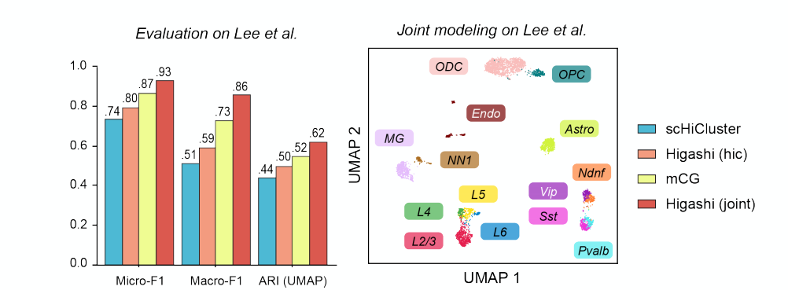
Embeddings from Higashi reflect cell identity information
Evaluation on public scHi-C datasets
Logistic regression + Micro-F1 / Macro-F1
K-means clustering + ARI (adjusted rand index)
Higashi outperforms existing methods for identifying cell types / cellular states
Joint modeling of co-assayed signals further improves the performance
scHiCluster: Zhou et al., PNAS, 2019
Notes:
At first, author get some public scHi-C datasets, compare with Higashi and other way to generate embedding
with evaluation measure, there are two strategies, one is supervise with few cells to train, and generate embedding to predict classification. measure on Micro-F1, Macro-F1
another using k-means clustering, and the results align with the ground truth, measure on ARI. that is unsupervised
that you can see joint part on Higashi embedding , it can differentiate cell type effectively

Slide 16
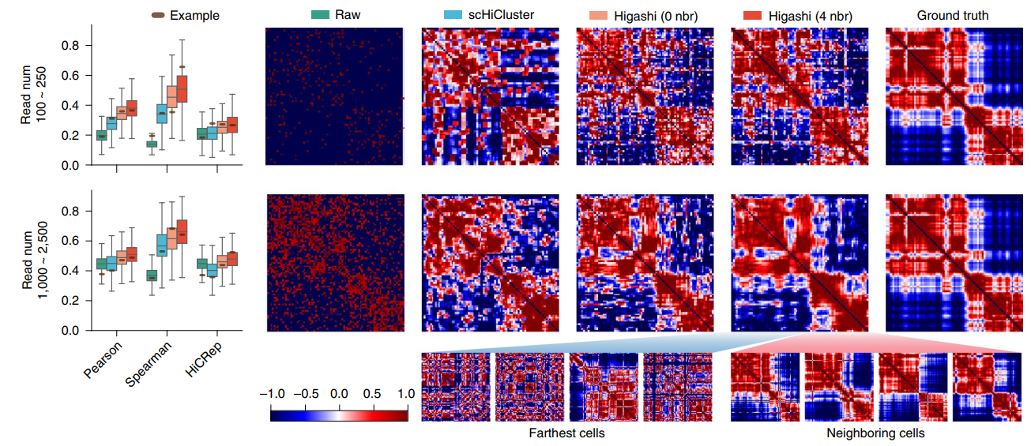
Higashi robustly imputes scHi-C contact maps
Simulating scHi-C from multiplexed 3D genome imaging data
Higashi (0 nbr) already outperforms baseline methods
Higashi (4 nbr) further improves the imputation accuracy
Similar conclusion with simulation from Su et al. Cell, 2020
Bintu et al. Science, 2018
Notes:
For more precisely evalution , author use imaging data as ground truth. left side is original image. Right is ground truth from author.
As continue, we compare to hyper parameters k with best imputation approach —scHiCluster so far.
So we could see that in Higashi method is more similiar to ground truth.(point to right-right)
Then you can outline more distinct the farthest cells to neighboring cells
As we reproduce to show later as well.

Slide 17
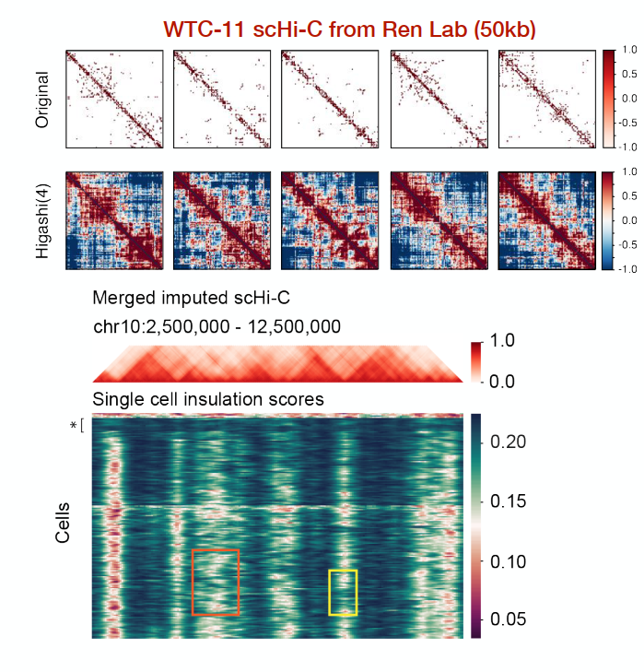
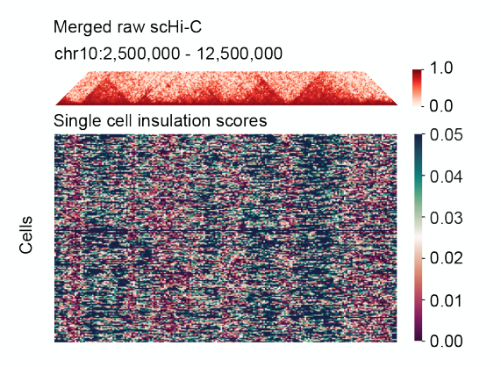
Single cell TAD-like domain boundary identification
Variability of TAD boundaries:
On/off
Sliding along the genome
Notes:
the top-right graph shows that difference with contact map before and after imputation
below is heat map for insulation score , consider row as each cell, column as genomic region
more heat with red color represtent more possible domain boundary which as local minimum
right side is after imputation and TADs boundaries more clearly
(TADs : Topologically associating domains)

Slide 18
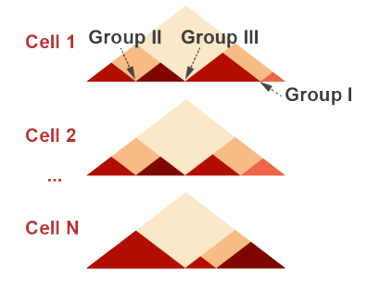
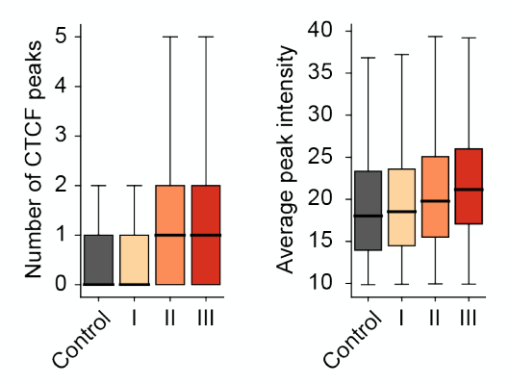
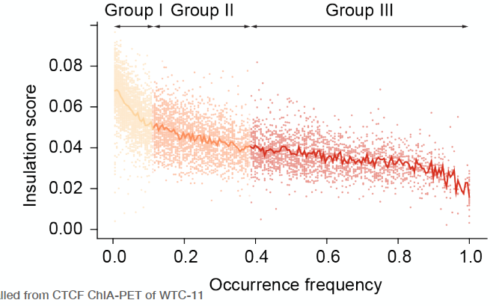
Properties of the single cell TAD-like boundaries
Each element corresponds to a single-cell domain boundary
TAD boundaries with higher occurrence frequencies
Lower single cell insulation scores
More CTCF peaks
Higher average CTCF peak intensity
Notes:
after , author would like to analysis relationship with other signal
first by frequency
bottom-left scatter plot show relationship in insulation of single cell domain boundaries, and the scores and frequency are negative related
bottom-right show more frequency occurs, usually target region around more CTCF peaks

Slide 19
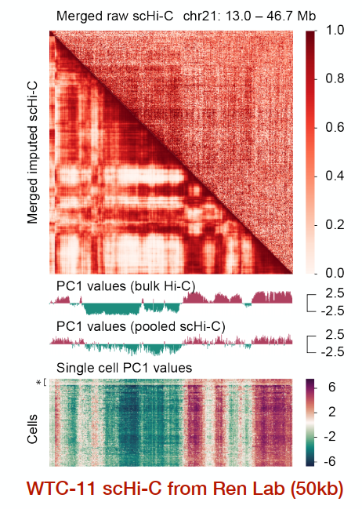
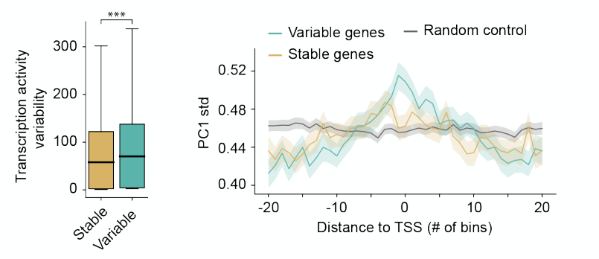
Single cell A/B compartment variability
Bulk projection matrix for single cell Hi-C PCA (scA/B)
Variability of A/B compartment correlates with the variability of transcription activity
Notes:
analysing with WTC11 and calculating A B compartment with PC1
bottom-right as a result to chromosome 12 , each cell as row, and column corresponding to gene region
bottom-middle could tell bulk Hi-C and scHi-C values about the same, meanwhile single cell variable observed
and two of left
it’s use standard deviation of PC 1 score to be variablility of A B compartment, and use variable exponent of single cell RNA seek data to be variablility of transcription
then we seperate gene region into stable compartment and high-variable compartment. the higher one indicates high variability of transcription

Slide 20
04
Our Reproduction

Slide 21
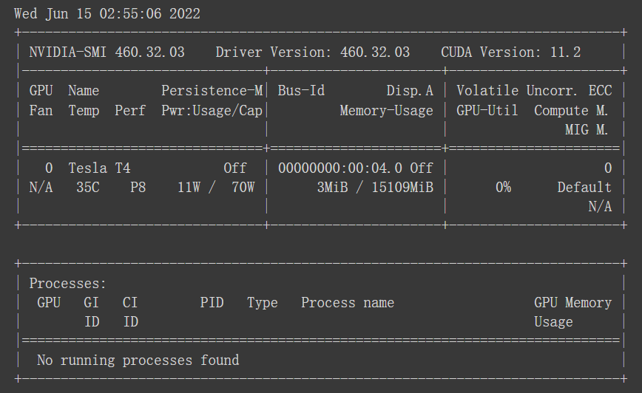
Environment settings
Platform selection
We tested several development environments:Win10、 WSL、VM(ubuntu18.04):
Win10: cython & cooler problem → need mingw or visualstudio 🛑
WSL: Cuda is difficult to set up. 🛑(15 hour)
VM(ubuntu18.04): CPU is too slow and Our GPU is run out of memory 🛑
Colab: The latest pytorch environment has been installed and Powerful GPU 👍🏻(4 hour)
GPU in colab (random):
R-80, K80, T4, P100
What we use:
P100
Notes:
最後我們選用在COLAB上架設環境並使用P100 GPU。
在wsl沒有GPU的情況，預期至少跑超過15個小時，在colab環境中則是花費約4個小時完成。
try with serveral development environments,
we use powerful GPU colab environments.
In wsl and it’s GPU off , we expected program need to run more than 15 hours, on the other hand, colab cost about 4 hours.

Slide 22
Input data format
Files we need
data.txt: input data
config_ramani.JSON: Used to set all the parameters used by all the different tasks (more..)
label_info.pickle: label
hg19.chrom.sizes.txt: genome reference file from USCS Genome Browser, will be used to generate bin nodes.
cytoBand_hg19.txt: cytoband reference file from USCS Genome Browser, will be used to remove centromere regions.
Notes:
what we input is main data
config to set parameters
label store pickle data
genome reference file to generate bin nodes
cytoband reference to remove centromere regions

Slide 23
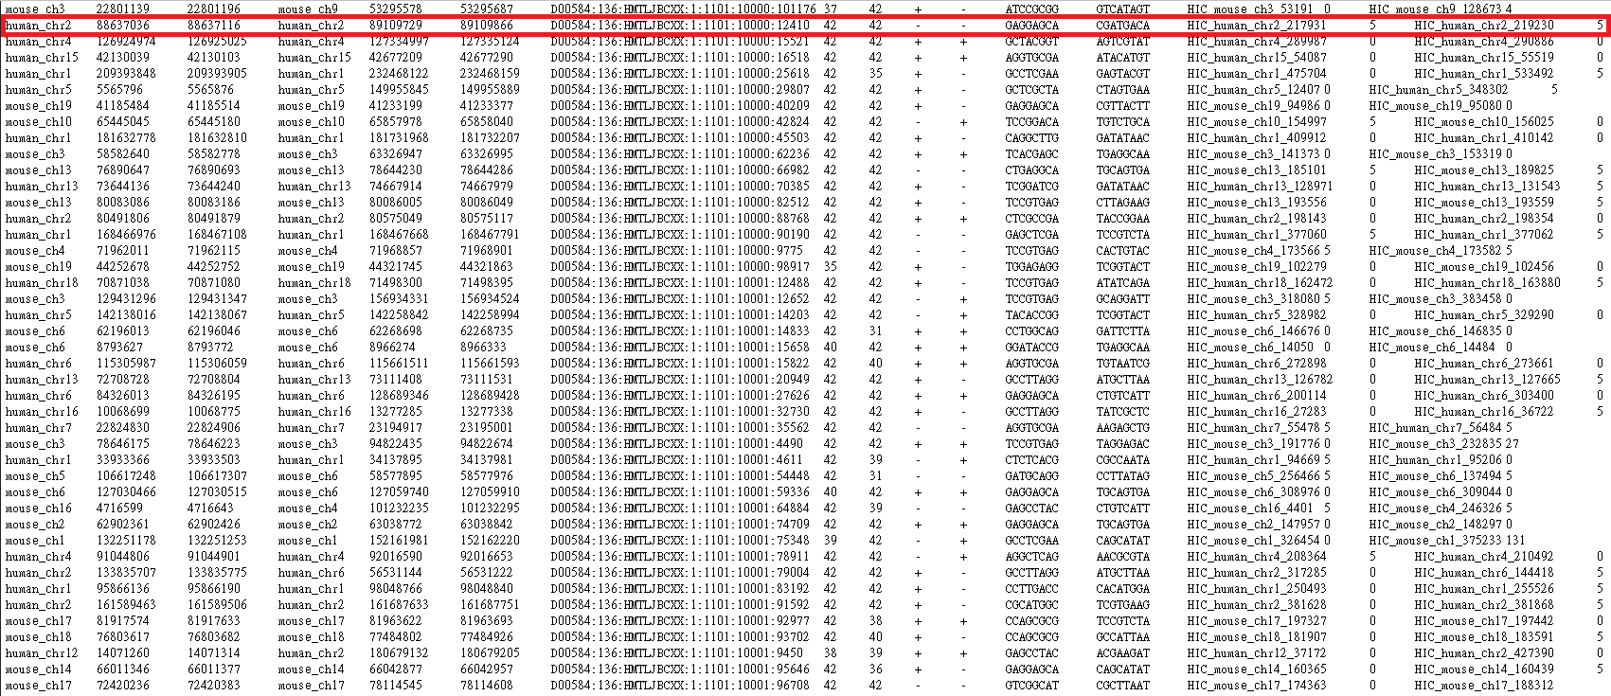
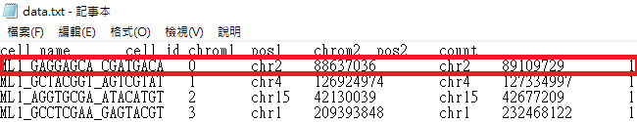
Input data format
GSE84920(NCBI)
1.GSM2254215_ML1.validPairs.txt(4.47G)
2.GSM2254217_ML3.validPairs.txt(860MB)
Part of the ML1 file 👉🏻
Data.txt
Process GSE84920 file to fit "higashi_v1" format
Data.txt(863MB)
Part of the Data.txt file 👉🏻
https://github.com/ma-compbio/Higashi/wiki/Input-Files
Notes:
GSE84920中混雜著人類與老鼠的基因資料，我們提取其中的人類染色體資料使其符合higashi v1的格式。
data.txt中的
cell_id: id for each cell, start from 0. Must be continuous
chrom: chromosome name for fragment
pos: location for fragment
the dataset GSE84920 mashup human and mouse gene data
we extract human genome among the set then be able to fit higashi model format

Slide 24
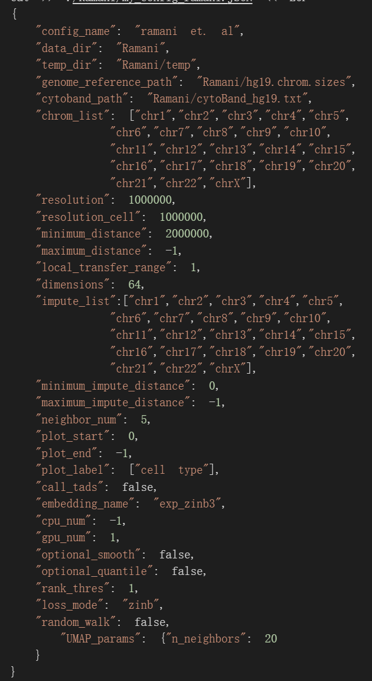
Input data format
Configure the parameters
All customizable parameters are stored in a JSON config file. The path to this JSON config file will be needed when running the program.
For examples of the configuration JSON file 👉🏻
Important parameters
data_dir: Path to the folder that store data.txt
genome_reference_path: Path to the genome reference file
cytoband_path: Path to the cytoband reference file
Configure the parameters · ma-compbio/Higashi Wiki (github.com)
Notes:
there are some more important parameters for your information
from data processing, training and last visualization
more about the whole pipeline usage
這是主要使用的 config 檔，從資料處理、訓練到最後視覺化都會用到。
比較重要的參數有這幾個檔案路徑。

Slide 25
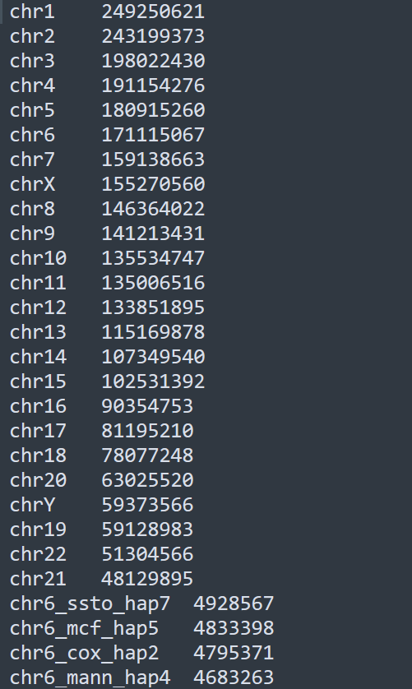
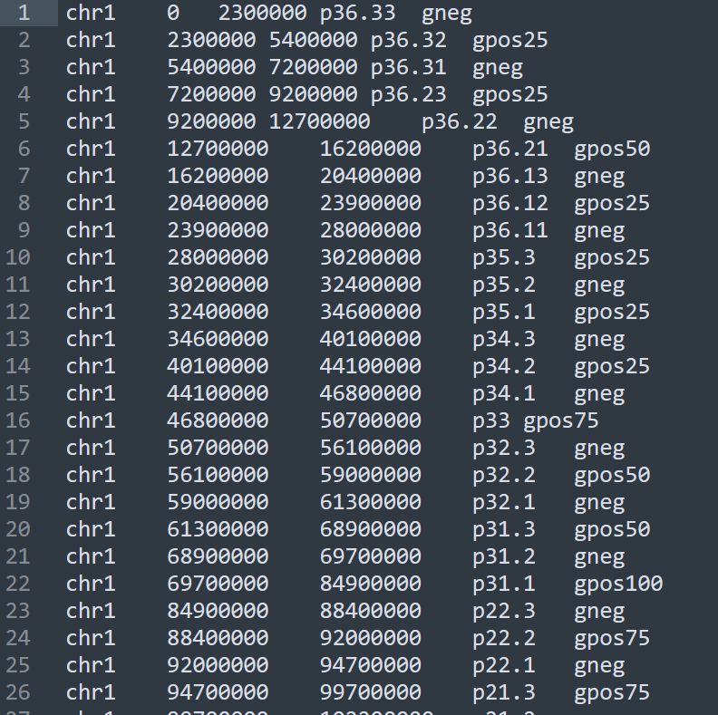
Input data format
Why we need genome reference ?
hg19.chrom.sizes.txt
cytoBand_hg19.txt:
As the cost of DNA sequencing falls, and new full genome sequencing technologies emerge, more genome sequences continue to be generated. Reference genomes are typically used as a guide on which new genomes are built, enabling them to be assembled much more quickly and cheaply than the initial Human Genome Project.
chr size
chr start end stain band
refer: Reference genome - Wikipedia
Notes:
due to Computational intractability on sequencing
there is well-known reference genomes to dictionary
一文读懂参考基因组和基因组注释+最全下载方法_白墨石的博客-CSDN博客_参考基因组
转录组入门（4）：了解参考基因组及基因注释 - 簡書 (jianshu.com)

Slide 26
Data processing
generate a dictionary that'll map genomic bin loci to the node id.
extract data from the data.txt and turn that into the format of hyperedges (triplets)
create contact maps based on sparse scHi-C for visualization, baseline model, and generate node attributes
Notes:
we’re going to data pipe as follow

Slide 27
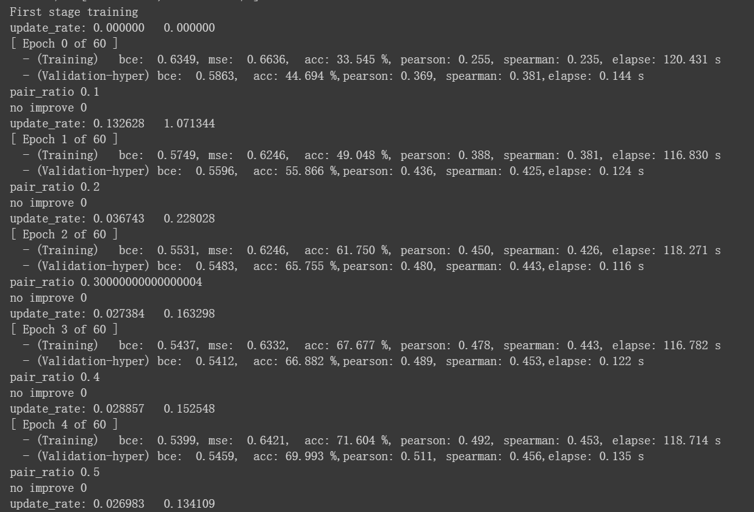
Train the Higashi model
1. Train Higashi without cell-dependent GNN to force self-attention layers to capture the heterogeneity of chromatin structures.(60 epoch)(we use 5)
2. Train Higashi with cell-dependent GNN, but with k=0.(45 epoch)
3. Train Higashi with cell-dependent GNN, but with k=`neighbor_num` in the config JSON.(30 epoch)
(we use 5)
Notes:
這邊有 3 組訓練任務，分別測試本實驗主要提出的想法， cell-dependent GNN 的使用與否、k=neighbor_num 的使用效果。(對應 p.12)
we use three training task to validate concept of the experiment
it’s about GNN usage and determine the k.

Slide 28
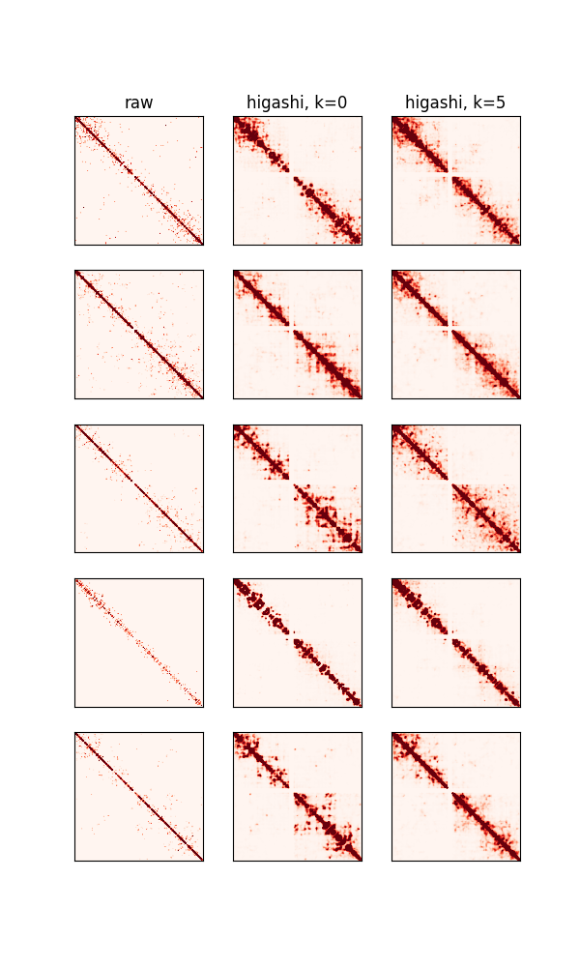
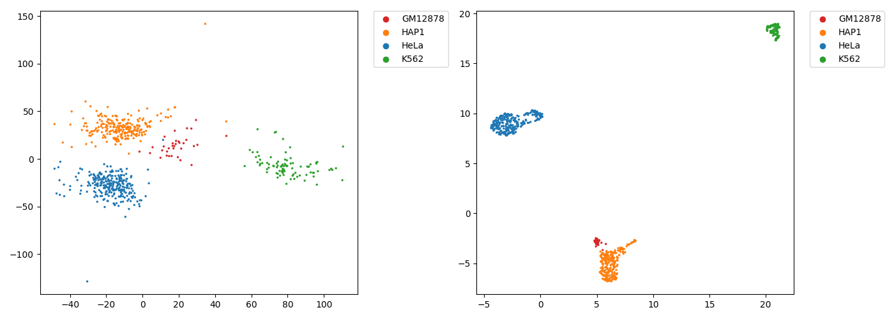
Our result
Imputation
embedding
PCA
UMAP
Notes:
Those are result above.
It’s constructing embedding and imputation with model from Higashi training
Left plot do visualize embedding result with PCA and UMAP
X direction is first principal component ,Y direction is second principal component
Legend told that using color to differentiate cell group.
as you can see, Higashi embedding result grouping clearly
Right side present different kind of result that indicates compare of raw data and imputation in different parameter
Each row means some fragment of Hi-C presentation
It’s more clear that compare with raw data
but even close in k equal to 0 and eaual to 5, that show some difference with author’s result
這些是我們本次實作出的結果，透過 higashi 訓練出的 modle 所建構的 embedding 和 imputation。
左圖是將 higashi 的 embedding 分別用 PCA 和 UMAP 視覺化出來，X軸是第一主成分，Y軸是第二主成分
右上角是圖利不同顏色表示不同的細胞群體。可以看到 higashi 的 embedding 已經可以將不同細胞群體分得很清楚。
右邊的圖是第三號染色體三種不同的結果，原始資料以及不同差補結果的比較。
每個 row 是三號染色體的某個片段的HIC呈現。分別由 raw 、 higashi 的 k =0 和 higashi 的 k =5 做比較，可以看到兩者和 raw 比起來已經比較不稀疏了，但是我們的 k=0 和 k=5 差別不大，和原作者做的有些落差。

Slide 29
Our target: Higashi robustly imputes scHi-C contact maps
擷取至: Multiscale and integrative single-cell Hi-C analysis - YouTube
Notes:
我們原本預期要完成與scHICluster的比對，但遇到了沒有GPU跑過久以及重新架設環境花費過多時間，缺失了與其比較。
Formerly expect to compare with scHi-Cluster approach
But we encounter time consuming problem on off GPU and reallocate resource.
So that missing the chance to do comparison.

Slide 30
Thanks for listening
Notes:
that’s all thank u.

